Slide 1



Kernel Density Visualization for Big Geospatial Data: Algorithms and Applications
(Edison) Tsz Nam Chan¹ Leong Hou U² Byron Choi¹
Jianliang Xu¹ Reynold Cheng³
¹Hong Kong Baptist University ²University of Macau ³The University of Hong Kong

Slide 2
Tutorial Outline
Background of hotspot visualization
Background of kernel density visualization (KDV)
State-of-the-art methods of generating KDV
Other variants of KDV
Software development of KDV and its variants
Future opportunities

Slide 3
Background of Hotspot Visualization

Slide 4
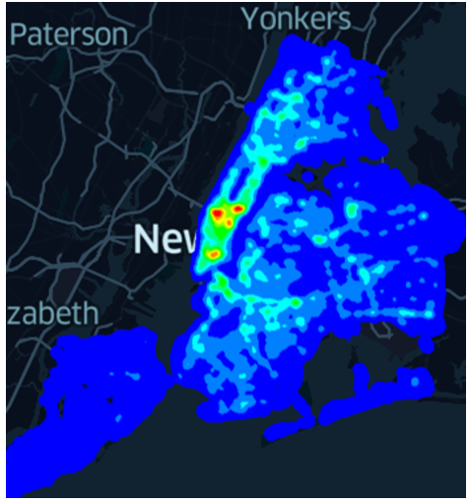
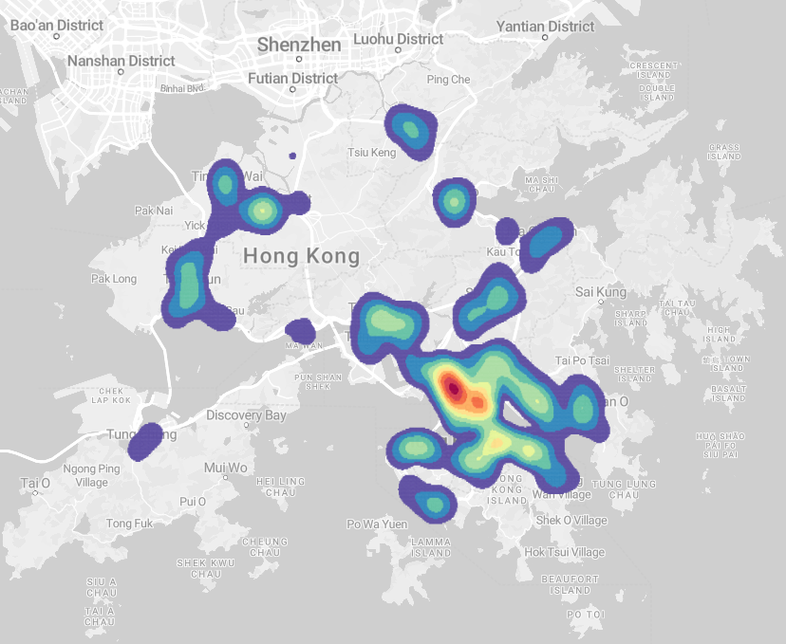
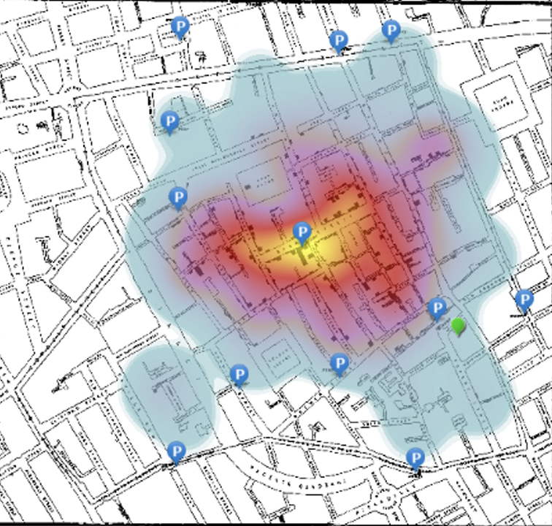
Why Hotspot Visualization?
Finding the hidden patterns of location data points in different regions.
COVID-19 cases
Traffic accidents
Traffic flows
Crime events
Providing an intuitive analysis of different location datasets.
New York traffic accident heatmap
Hong Kong COVID-19 heatmap
1854 London cholera epidemic

Slide 5
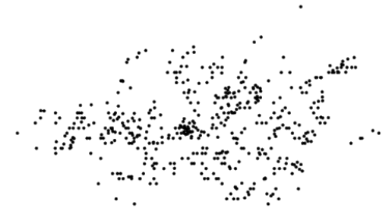
Scatter Plot
Directly plots data points in the map.
Scatter plot of the data points of
1854 London cholera epidemic
[LDAV15] A. Perrot, R. Bourqui, N. Hanusse F. Lalanne D. Auber, "Large Interactive Visualization of Density Functions on Big Data Infrastructure" LDAV2015

Slide 6
Advantages of Scatter Plot
Simple ☺
Show the patterns clearly for small data ☺
Efficient ☺

Slide 7
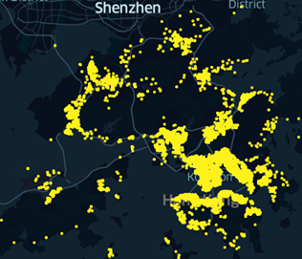
Overplotting Issues of Scatter Plot
Difficult to find which parts contain more data points (Overplotting) ☹
This issue is more serious if the number of data points is much larger than the resolution size.
Hong Kong COVID-19 cases

Slide 8
Overplotting Issues of Scatter Plot
Seriously suffers from the resolution changes ☹
Resolution: 512 x 512
Resolution: 256 x 256

Slide 9
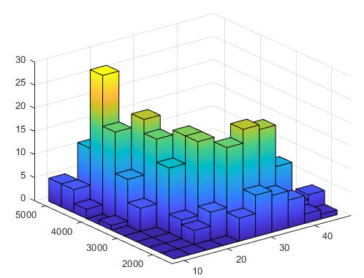
Histogram
Divides the space into different intervals/ sub-regions with the same size.
Counts the frequency in each interval/sub-region.
6
5
4
Frequency
3
2
1
0
10 - 15
15 - 20
20 - 25
25 - 30
30 - 35
Intervals

Slide 10
Advantages of Histogram
Simple ☺
Efficient ☺
Solve the overplotting issues ☺

Slide 11
Histogram is Sensitive to the Pixel Positions
Different starting points in the x-axis can significantly affect the visualization (link) ☹
6
6
5
5
4
4
Frequency
3
Frequency
3
2
2
1
1
0
0
10 - 15
15 - 20
20 - 25
25 - 30
12 - 17
30 - 35
17 - 22
22 - 27
27 - 32
32 - 37
Intervals
Intervals

Slide 12
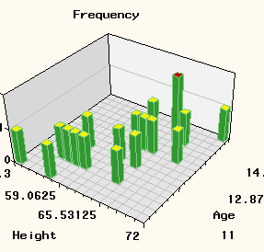
Histogram is Not Smooth
The visualization is not smooth (There can be a huge change between two consecutive bins) ☹

Slide 13
Background of Kernel Density Visualization (KDV)

Slide 14
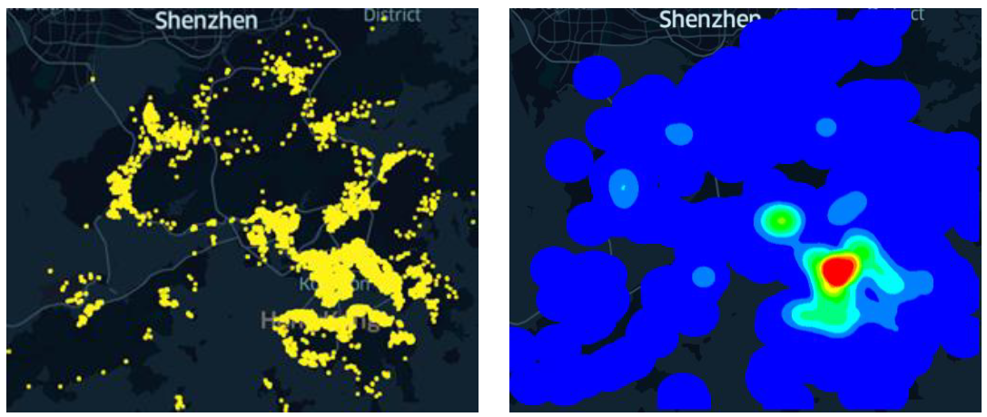
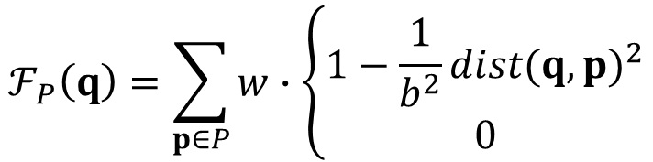
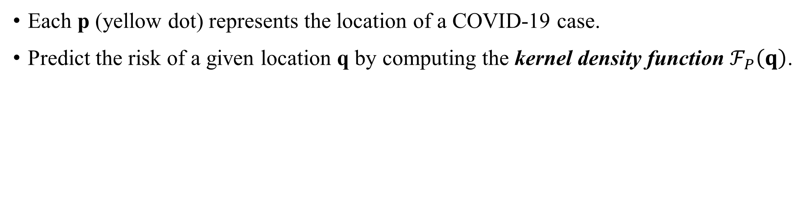
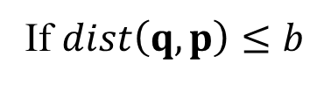
Kernel Density Visualization (KDV)
Each p (yellow dot) represents the location of a COVID-19 case.
Predict the risk of a given location q by computing the kernel density function $ℱ_{P}\left(q\right)$.
2D pixel
weighting
Euclidean distance
$$ℱ_{P}\left(q\right)=\sum_{p∈P}{w}∙\left\{\begin{matrix}1−\frac{1}{b^{2}}{dist(q,p)}^{2} \\ 0\end{matrix}\right.$$
If $dist\left(q,p\right)≤b$
Otherwise
dataset
bandwidth

Slide 15



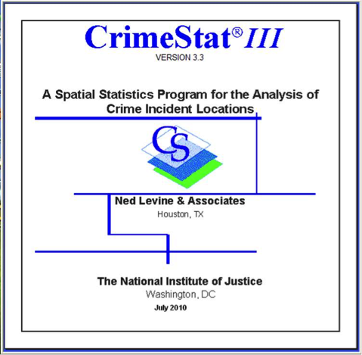


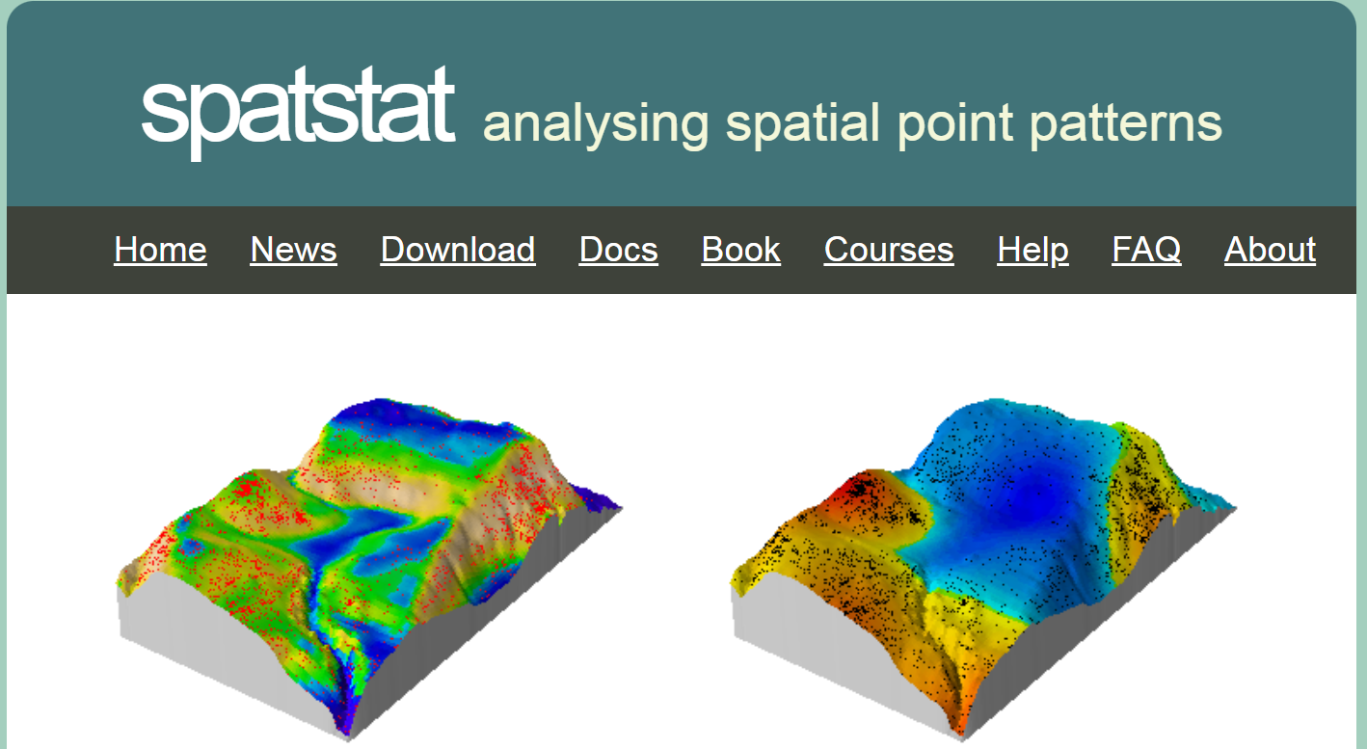


Software Packages for Supporting KDV

Slide 16
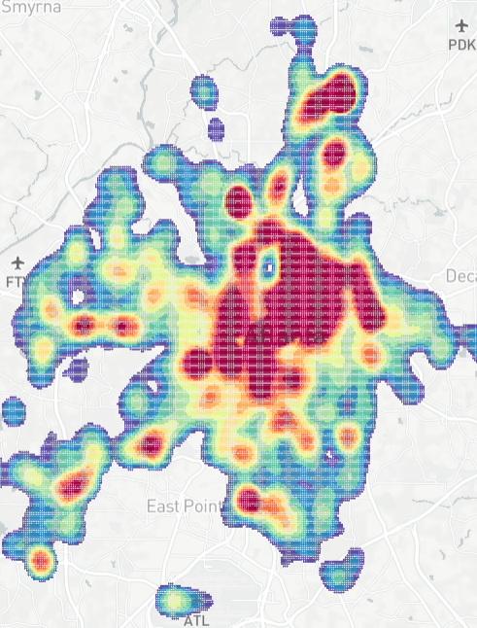
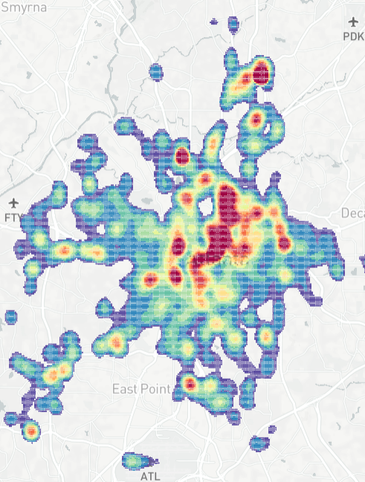
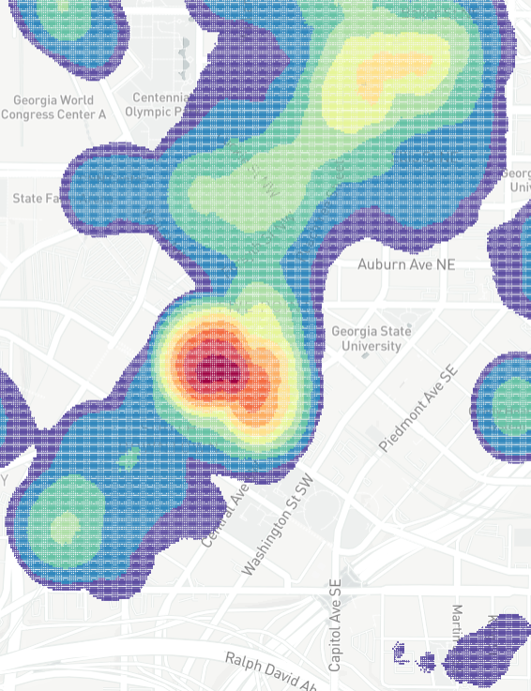
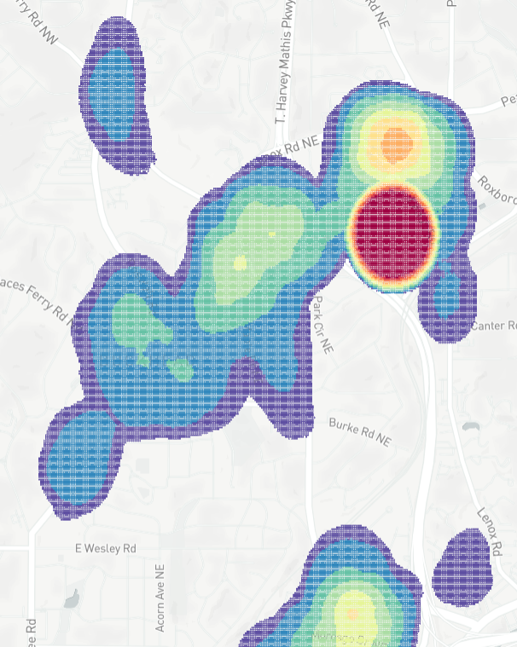
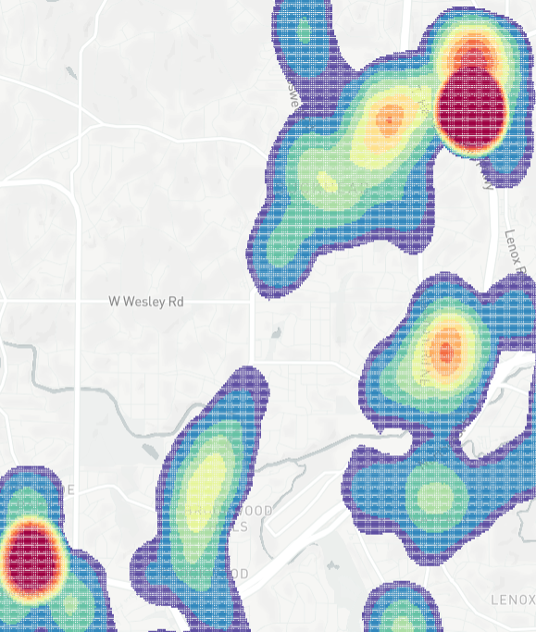





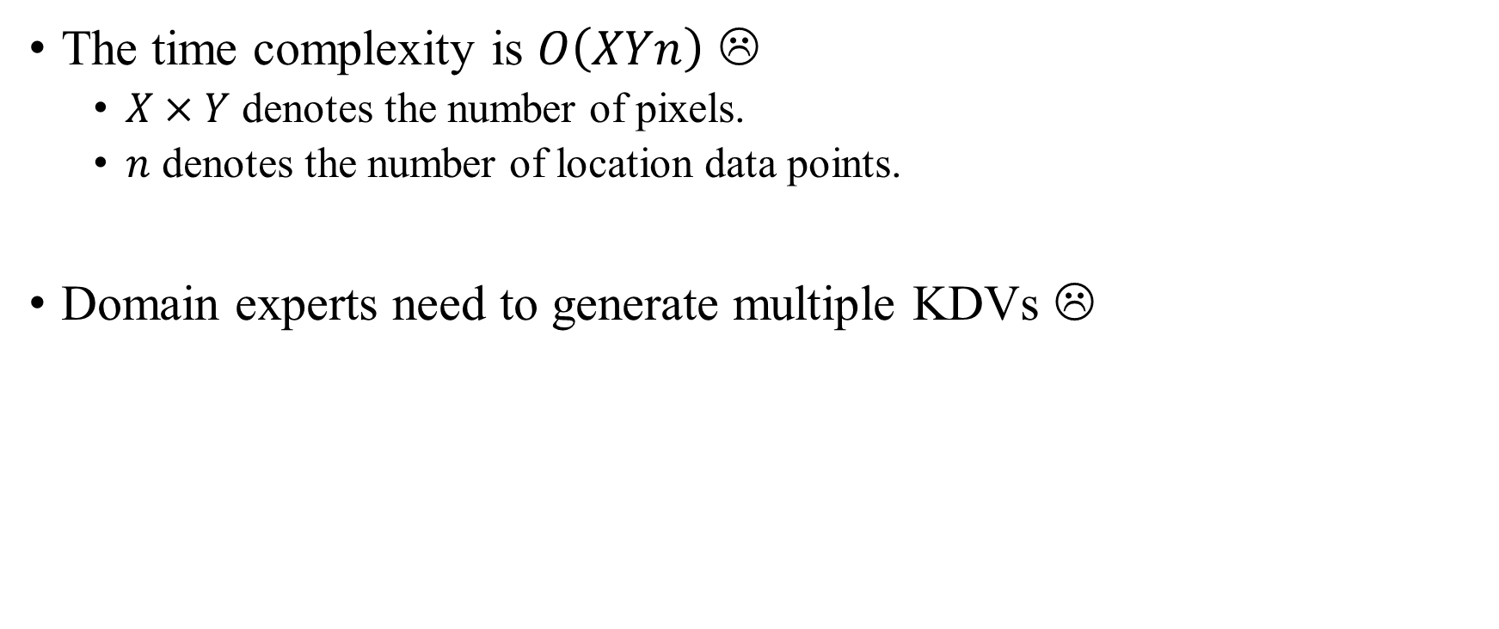
KDV is Slow!
The time complexity is $O\left(XYn\right)$ ☹
$X×Y$ denotes the number of pixels.
$n$ denotes the number of location data points.
Domain experts need to generate multiple KDVs ☹
B
Bandwidth
selection
Zoom in
Panning
Zoom out
Many exploratory
operations
(e.g., filtering)

Slide 17
KDV is Slow!
Many complaints from domain experts:
Zhang [TGIS22] “Taking computation processes underlying the KDE-based method (modeling, prediction, and integration) literally, one would apply the sequence of computation steps cell-by-cell to generate a final suitability map. That is, using the covariate value at one cell as an input to compute a final suitability value before repeating the same computations at the next cell. However, this is computationally inefficient as computations may be unnecessarily repeated.”
Gramacki et al. [SIP17] “However, many (or even most) of the practical algorithms and solutions designed in the context of KDE are very time-consuming with quadratic computational complexity being a commonplace.”
Gan et al. [SIGMOD17] “Kernel Density Estimation (KDE) is a powerful technique for computing these densities, offering excellent statistical accuracy but quadratic total runtime.”
[TGIS22] G. Zhang. PyCLKDE: A big data-enabled high-performance computational framework for species habitat suitability modeling and mapping. Transactions in GIS, 2022.
[SIP17] A. Gramacki. Nonparametric Kernel Density Estimation and Its Computational Aspects. Springer International Publishing, 2017.
[SIGMOD17] E. Gan and P. Bailis. Scalable Kernel Density Classification via Threshold-Based Pruning. SIGMOD 2017.

Slide 18
State-of-the-art Methods of Generating KDV

Slide 19
State-of-the-art Methods for Generating KDV
Function approximation [TKDE22, SIGMOD20, ICDE19, SIGMOD17, SDM03]
Data sampling [SOCG18, SODA18, SODA13, SIGMOD13]
Computational sharing [VLDB22a, AISTATS03]
Computational geometry [SIGMOD22]
[TKDE22] T. N. Chan, L. H. U, R. Cheng, M. L. Yiu, Shivansh Mittal. Efficient Algorithms for Kernel Aggregation Queries. TKDE 2022.
[SIGMOD22] T. N. Chan, L. H. U, B. Choi, J. Xu. SLAM: Efficient Sweep Line Algorithms for Kernel Density Visualization. SIGMOD 2022.
[VLDB22a] T. N. Chan, P. L. Ip, L. H. U, B. Choi, J. Xu. SAFE: A Share-and-Aggregate Bandwidth Exploration Framework for Kernel Density Visualization. VLDB 2022.
[SIGMOD20] T. N. Chan, R. Cheng, M. L. Yiu. QUAD: Quadratic-Bound-based Kernel Density Visualization. SIGMOD 2020.
[ICDE19] T. N. Chan, M. L. Yiu, L. H. U. KARL: Fast Kernel Aggregation Queries. ICDE 2019.
[SOCG18] J. M. Phillips and W. M. Tai. Near-Optimal Coresets of Kernel Density Estimates. SOCG 2018.
[SODA18] J. M. Phillips and W. M. Tai. Improved Coresets for Kernel Density Estimates. SODA 2018.
[SIGMOD17] E. Gan and P. Bailis. Scalable Kernel Density Classification via Threshold-Based Pruning. SIGMOD 2017.
[SODA13] J. M. Phillips. ϵ-Samples for Kernels. In SODA 2013.
[SIGMOD13] Y. Zheng, J. Jestes, J. M. Phillips, F. Li. Quality and Efficiency for Kernel Density Estimates in Large Data. SIGMOD 2013.
[SDM03] A. G. Gray and A. W. Moore. Nonparametric Density Estimation: Toward Computational Tractability. SDM 2003.
[AISTATS03] A. G. Gray and A. W. Moore. Rapid Evaluation of Multiple Density Models. AISTATS 2003.

Slide 20
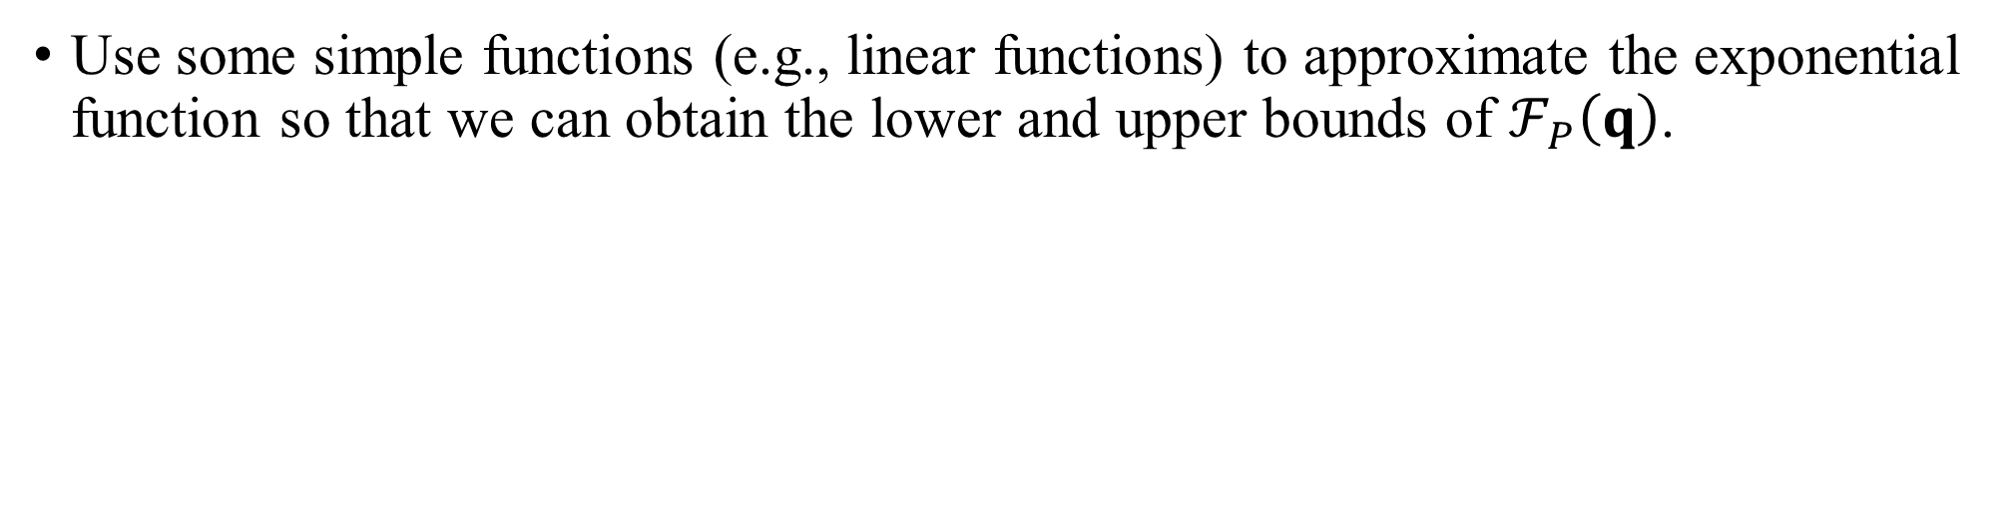
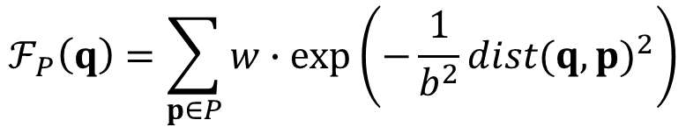
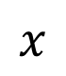
Function Approximation
Consider the kernel density function (with the Gaussian kernel).
$$ℱ_{P}\left(q\right)=\sum_{p∈P}{w}∙exp⁡\left(−\frac{1}{b^{2}}{dist(q,p)}^{2}\right)$$
$$x$$
Use some simple functions (e.g., linear functions) to approximate the exponential function so that we can obtain the lower and upper bounds of $ℱ_{P}\left(q\right)$.
x_{min}
x_{max}
x_{min}
x_{max}
x₁
x₂
x₁
E^{U}(x)=m_{u} x + c_{u}
x₃
function
exp(–x)
x₂
function
exp(–x)
E^{L}(x)=m_{l} x + c_{l}
x₃

Slide 21
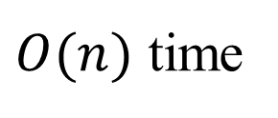
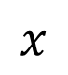
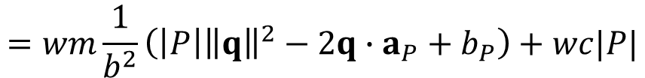
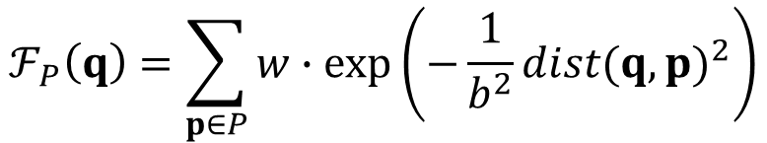
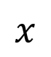
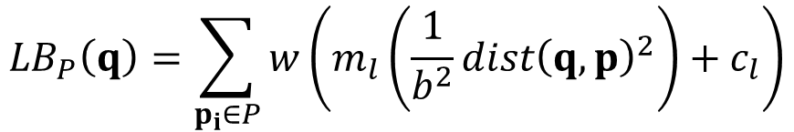

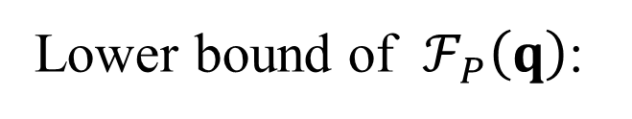
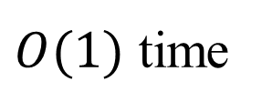
Function Approximation
$$ℱ_{P}\left(q\right)=\sum_{p∈P}{w}∙exp⁡\left(−\frac{1}{b^{2}}{dist(q,p)}^{2}\right)$$
$O(n)$ time
$$x$$
We have ${LB}_{P}\left(q\right)≤ℱ_{P}\left(q\right)≤{UB}_{P}\left(q\right)$.
Lower bound of $ℱ_{P}\left(q\right)$:
$${LB}_{P}\left(q\right)=\sum_{p_{i}∈P}{w}\left(m_{l}\left(\frac{1}{b^{2}}{dist\left(q, p\right)}^{2}\right)+c_{l}\right)$$
$$x$$
$$=wm\frac{1}{b^{2}}\left(\left|P\right|{\left\|q\right\|}^{2}−2q∙a_{P}+b_{P}\right)+wc|P|$$
$O(1)$ time
O(1)
O(1)
We can further tighten these bound values using some index structures (e.g., kd-tree) until they fulfill the relative error guarantees.

Slide 22
Advantages and Disadvantages of Function Approximation
Advantages ☺
Achieve better practical performance.
Can handle all kernel functions.
Can achieve approximation guarantees for generating KDV.
Disadvantages ☹
Cannot reduce the worst-case time complexity for generating KDV.
Cannot achieve exact solution.
Can still be slow for generating KDV with some famous kernel functions (Epanechnikov and quartic kernels).

Slide 23
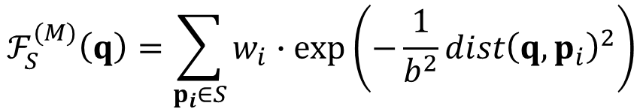
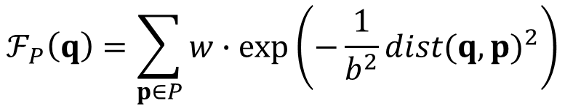
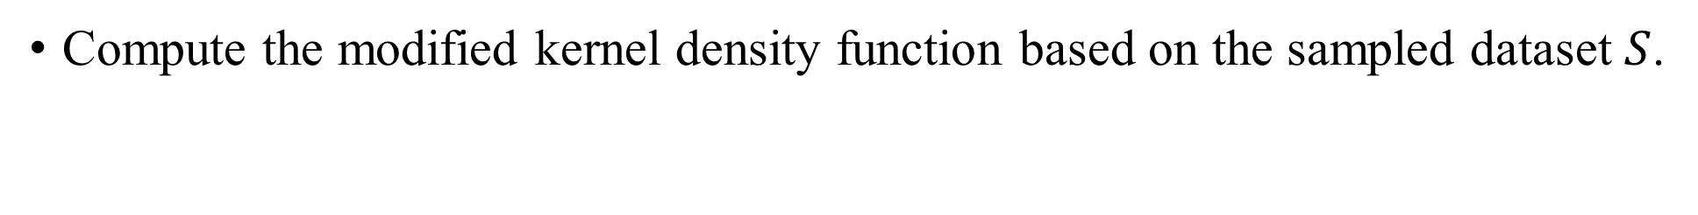
Data Sampling
Consider the kernel density function (with the Gaussian kernel).
$$ℱ_{P}\left(q\right)=\sum_{p∈P}{w}∙exp⁡\left(−\frac{1}{b^{2}}{dist(q,p)}^{2}\right)$$
Sampling
Compute the modified kernel density function based on the sampled dataset $S$.
$$ℱ_{S}^{(M)}\left(q\right)=\sum_{p_{i}∈S}{w_{i}}∙exp⁡\left(−\frac{1}{b^{2}}{dist\left(q,p_{i}\right)}^{2}\right)$$

Slide 24
Advantages and Disadvantages of Data Sampling
Advantages ☺
Can achieve probabilistic approximation guarantees for generating KDV.
Can reduce the worst-case time complexity for generating KDV.
Can handle all kernel functions.
Disadvantages ☹
Cannot achieve exact solution.
Can still be slow for generating KDV.
Can degrade the practical visualization quality.

Slide 25
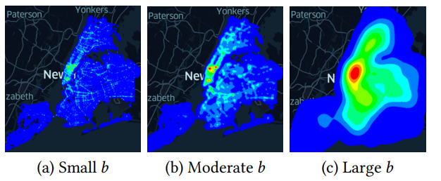
Computational Sharing
Different bandwidth parameters b can significantly affect the visualization.

Slide 26
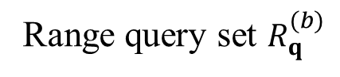
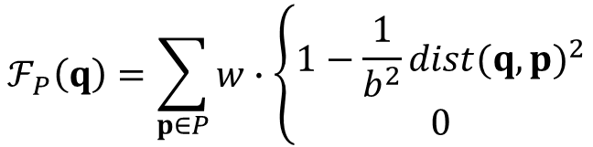
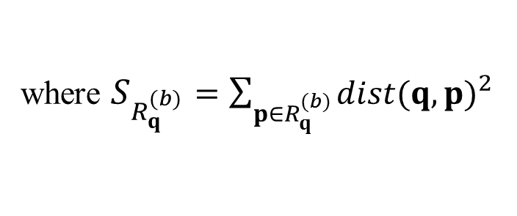
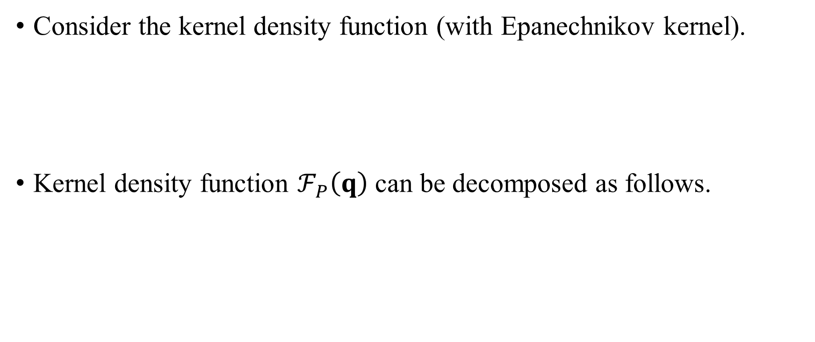
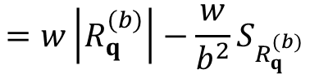
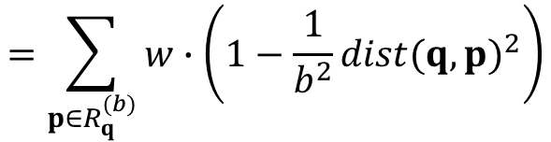
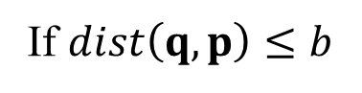
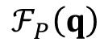
Computational Sharing
Consider the kernel density function (with Epanechnikov kernel).
Kernel density function $ℱ_{P}\left(q\right)$ can be decomposed as follows.
$$ℱ_{P}\left(q\right)=\sum_{p∈P}{w}∙\left\{\begin{matrix}1−\frac{1}{b^{2}}{dist(q,p)}^{2} \\ 0\end{matrix}\right.$$
If $dist\left(q,p\right)≤b$
Otherwise
$$=\sum_{p∈R_{q}^{(b)}}{w}∙\left(1−\frac{1}{b^{2}}{dist(q,p)}^{2}\right)$$
$$ℱ_{P}\left(q\right)$$
b
q
$$=w\left|R_{q}^{(b)}\right|−\frac{w}{b^{2}}S_{R_{q}^{(b)}}$$
where $S_{R_{q}^{(b)}}=\sum_{p∈R_{q}^{(b)}}{{dist(q,p)}^{2}}$
Range query set $R_{q}^{(b)}$

Slide 27
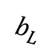
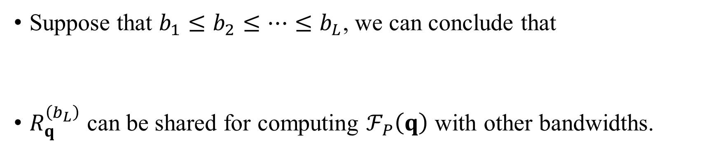
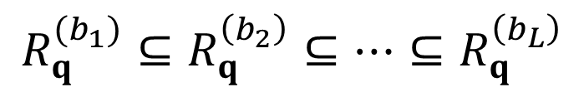
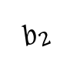
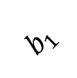
Computational Sharing
…
…
$$b_{L}$$
$$b_{2}$$
$$b_{1}$$
q
…
…
Suppose that $b_{1}≤b_{2}≤…≤b_{L}$, we can conclude that
$R_{q}^{\left(b_{L}\right)}$ can be shared for computing $ℱ_{P}\left(q\right)$ with other bandwidths.
$$R_{q}^{(b_{1})}⊆R_{q}^{\left(b_{2}\right)}⊆…⊆R_{q}^{\left(b_{L}\right)}$$

Slide 28
Advantages and Disadvantages of Computational Sharing
Advantages ☺
Can achieve the exact solution for generating multiple KDVs.
Can reduce the worst-case time complexity for generating multiple KDVs.
Can achieve better practical efficiency for generating multiple KDVs.
Can combine with data sampling methods for generating multiple KDVs.
Disadvantages ☹
Cannot support all kernel functions (e.g., cannot support Gaussian kernel).
Cannot achieve optimal worst-case time complexity.
Cannot reduce the worst-case time complexity for generating a single KDV.

Slide 29
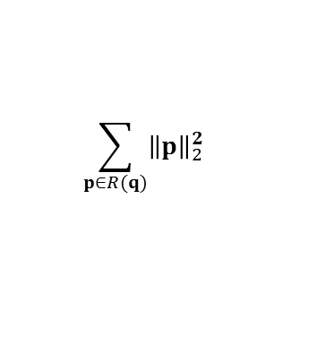
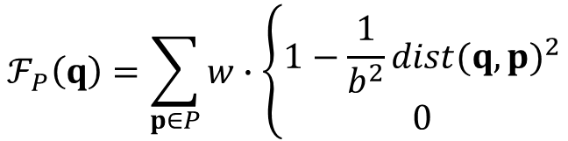
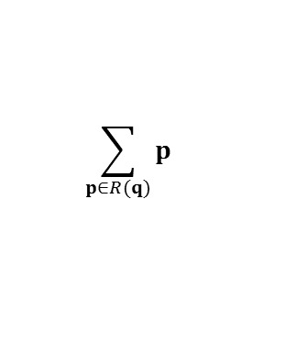






Computational Geometry
Consider the kernel density function (with Epanechnikov kernel).
Kernel density function $ℱ_{P}\left(q\right)$ can be decomposed as follows.
$$ℱ_{P}\left(q\right)=\sum_{p∈P}{w}∙\left\{\begin{matrix}1−\frac{1}{b^{2}}{dist(q,p)}^{2} \\ 0\end{matrix}\right.$$
If $dist\left(q,p\right)≤b$
Otherwise
$$ℱ_{P}\left(q\right)=\sum_{p∈R(q)}{w∙\left(1−\frac{1}{b^{2}}{dist(q,p)}^{2}\right)}$$
b
q
$$=w\left|R\left(q\right)\right|−\frac{w}{b^{2}}\left(\left|R\left(q\right)\right|×{\left\|q\right\|}_{2}^{2}−2q^{T}A_{R_{q}}+S_{R_{q}}\right)$$
$$\sum_{p∈R(q)}{p}$$
$$\sum_{p∈R(q)}{{\left\|p\right\|}_{2}^{2}}$$
Range query set $R\left(q\right)$
How to efficiently maintain $R(q)$?

Slide 30









Computational Geometry
X
…
$$b$$
…
…
…
…
$$\left(q_{1}.x,k\right)$$
$$\left(q_{3}.x,k\right)$$
…
q₁
q₂
q_{X-1}
q_{X}
Y
$$E(k)$$
…
$$\left(q_{2}.x,k\right)$$
$$\left(q_{X}.x,k\right)$$
…
…
…
…
$$q_{1}.y=q_{2}.y=…=q_{X}.y=k$$
$$X$$
Use $O(n)$ time to find the envelope $E(k)$.

Slide 31






Computational Geometry
Consider the blue data points $p$ that are within the range $b$ of the pixel $q$.
We can let:
$O(n)$ time to find the bound functions for all data points in $E(k)$.
p₁
$$b$$
p₂
$$\left(q.x,k\right)$$
p₃
p₄

Slide 32

Computational Geometry
q.x
p₁
LB_{k}(p₁)
UB_{k}(p₁)
p₁
$$b$$
p₂
p₂
LB_{k}(p₂)
UB_{k}(p₂)
p₃
$$\left(q.x,k\right)$$
LB_{k}(p₃)
UB_{k}(p₃)
p₃
p₄
p₄
LB_{k}(p₄)
UB_{k}(p₄)
x-axis
Range search problem = Interval stabbing problem.
Our sweep line algorithm (SLAM) can generate KDV in $O(Y(X+n))$ time ☺

Slide 33
Advantages and Disadvantages of Computational Geometry
Advantages ☺
Can achieve the exact solution
Can reduce the worst-case time complexity
Can achieve the best practical efficiency
Can combine with data sampling methods
Disadvantages ☹
Cannot support all kernel functions (e.g., cannot support Gaussian kernel).
Cannot achieve optimal worst-case time complexity.

Slide 34
Other Variants of KDV

Slide 35





Variant 1: Spatiotemporal Kernel Density Visualization (STKDV)
KDV does not consider the occurrence time of each geographical event, which may provide misleading visualization results.
2nd August 2020
6th December 2020
Hong Kong COVID-19 cases
Hotspot map (based on KDV)
28th February 2021
28th January 2022

Slide 36


Variant 1: Spatiotemporal Kernel Density Visualization (STKDV)
Consider a location dataset $\hat{P}=\left\{\left(p_{1}, t_{p_{1}}\right),\left(p_{2}, t_{p_{2}}\right),…,\left(p_{n}, t_{p_{n}}\right)\right\}$ with size $n$.
Color each pixel $q$ with the timestamp $t_{q}$ based on the spatial-temporal kernel density function $ℱ_{\hat{P}}(q,t_{q})$.
2nd August 2020
6th December 2020
$$ℱ_{\hat{P}}\left(q,t_{q}\right)=\sum_{\left(p, { t}_{p}\right)∈\hat{P}}{w∙K_{space}}(q,p)∙K_{time}(t_{q},t_{p})$$
28th February 2021
28th January 2022

Slide 37

Variant 1: Spatiotemporal Kernel Density Visualization (STKDV)
Time complexity of a naïve solution is $O(XYTn)$ (Very slow!) ☹
The time complexity of the best solution, called SWS [VLDB22b], is $O(XY(T+n))$ ☺
[VLDB22b] T. N. Chan, P. L. Ip, L. H. U, B. Choi, J. Xu. SWS: A Complexity-Optimized Solution for Spatial-Temporal Kernel Density Visualization. VLDB 2022.

Slide 38





Core Idea 1 of SWS: Sliding Window
Establish the sliding window in the temporal dimension.
Only $\left(p_{1}, t_{p_{1}}\right)$, $\left(p_{2}, t_{p_{2}}\right)$, $\left(p_{3}, t_{p_{3}}\right)$, and $\left(p_{4}, t_{p_{4}}\right)$ can contribute to $ℱ_{\hat{P}}\left(q,t_{q}\right)$.
$$ℱ_{\hat{P}}\left(q,t_{q}\right)=\sum_{\left(p, { t}_{p}\right)∈\hat{P}}{w∙K_{space}}(q,p)∙\left\{\begin{matrix}1−\frac{1}{b_{τ}^{2}}{dist(t_{q},t_{p})}^{2} \\ 0\end{matrix}\right.$$
If $dist(t_{q},t_{p})≤b_{τ}$
Otherwise
$$=\sum_{\left(p, { t}_{p}\right)∈W(t_{q})}{w∙K_{space}}(q,p)∙\left(1−\frac{1}{b_{τ}^{2}}{dist(t_{q},t_{p})}^{2}\right)$$

Slide 39




Core Idea 1 of SWS: Sliding Window
Establish the sliding window in the temporal dimension.
Only $\left(p_{1}, t_{p_{1}}\right)$, $\left(p_{2}, t_{p_{2}}\right)$, $\left(p_{3}, t_{p_{3}}\right)$, and $\left(p_{4}, t_{p_{4}}\right)$ can contribute to $ℱ_{\hat{P}}\left(q,t_{q}\right)$.
$$ℱ_{\hat{P}}\left(q,t_{q}\right)=\sum_{\left(p, { t}_{p}\right)∈W(t_{q})}{w∙K_{space}}(q,p)∙\left(1−\frac{1}{b_{τ}^{2}}{dist(t_{q},t_{p})}^{2}\right)$$
$$ℱ_{\hat{P}}\left(q,t_{q}\right)=\sum_{\left(p, { t}_{p}\right)∈W(t_{q})}{w∙K_{space}}(q,p)∙\left(1−\frac{1}{b_{τ}^{2}}{dist(t_{q},t_{p})}^{2}\right)$$
$$=w\left(1−\frac{1}{b_{τ}^{2}}t_{q}^{2}\right)∙S_{W\left(t_{q}\right)}^{\left(0\right)}\left(q\right)+\frac{2w}{b_{τ}^{2}}t_{q}∙S_{W\left(t_{q}\right)}^{\left(1\right)}\left(q\right)−\frac{w}{b_{τ}^{2}}∙S_{W\left(t_{q}\right)}^{\left(2\right)}\left(q\right)$$
$$S_{W\left(t_{q}\right)}^{\left(i\right)}\left(q\right)=\sum_{\left(p, { t}_{p}\right)∈W(t_{q})}{t_{p}^{i}∙K_{space}(q,p)}$$

Slide 40

Core Idea 2 of SWS: Incremental Computation
$$S_{W\left(t_{q_{n}}\right)}^{\left(i\right)}\left(q\right)=S_{W\left(t_{q}\right)}^{\left(i\right)}\left(q\right)−\sum_{\left(p, { t}_{p}\right)∈D\left(W\left(t_{q}\right),W\left(t_{q_{n}}\right)\right)}{t_{p}^{i}∙K_{space}\left(q,p\right)}+\sum_{\left(p, { t}_{p}\right)∈I(W\left(t_{q}\right),W\left(t_{q_{n}}\right))}{t_{p}^{i}∙K_{space}(q,p)}$$
The time complexity is
$$O\left(\left|I\left(W\left(t_{q}\right),W\left(t_{q_{n}}\right)\right)\right|+\left|D\left(W\left(t_{q}\right),W\left(t_{q_{n}}\right)\right)\right|\right)$$

Slide 41



Core Idea 2 of SWS: Incremental Computation
$$O\left(\left|W_{t_{q_{1}}}\right|+\sum_{i=1}^{T−1}{\left|I\left(W\left(t_{q_{i}}\right),W\left(t_{q_{i+1}}\right)\right)\right|}+\sum_{i=1}^{T−1}{\left|D\left(W\left(t_{q_{i}}\right),W\left(t_{q_{i+1}}\right)\right)\right|+T}\right)$$
The time complexity is
$$=O\left(T+n\right)$$
There are $X×Y$ pixels $⇒$ Generating STKDV is $O\left(XY(T+n)\right)$ time ☺

Slide 42



Variant 2: Network Kernel Density Visualization (NKDV)
KDV ignores the road network
Can overestimate the density value of some regions (e.g., q₂)
Cannot correctly identify which road segments are the hotspot.
q₂
Road 1
Road 2
q₁
Kernel Density Visualization (KDV)
Network Kernel Density Visualization (NKDV)

Slide 43



Variant 2: Network Kernel Density Visualization (NKDV)
Divide each road in the road network $G=(V,E)$ into a set of lixels.
Color each lixel q, based on the network kernel density function.
weighting
shortest path distance
lixel
$$ℱ_{P}\left(q\right)=\sum_{p∈P}{w}∙\left\{\begin{matrix}1−\frac{1}{b^{2}}{{dist}_{G}(q,p)}^{2} \\ 0\end{matrix}\right.$$
if ${dist}_{G}\left(q,p\right)≤b$
otherwise
dataset
bandwidth
q₂
Road 1
Road 1
Road 2
q₁
Road 2
q
q₁

Slide 44


Variant 2: Network Kernel Density Visualization (NKDV)
Time complexity of a naïve solution is $O(L\left(T_{SP}+n\right))$ (Very slow!) ☹
$L$ is the number of lixels.
$T_{SP}$ is the time complexity of a shortest path algorithm.
$n$ is the number of data points.
Time complexity of the best solution, ADA [VLDB21a], is $O\left(|E|\left(T_{SP}+L\log\left(\frac{n}{|E|}\right)\right)\right)$ time (Why?).
[VLDB21a] T. N. Chan, Z. Li, L. H. U, J. Xu, R. Cheng. Fast Augmentation Algorithms for Network Kernel Density Visualization. VLDB 2021.

Slide 45








Core Idea 1 of ADA: Decomposition of Kernel Density Function
The kernel density function can be represented by multiple edge-e kernel density functions.
$$ℱ_{P}\left(q\right)=\sum_{p∈P}{w}∙\left\{\begin{matrix}1−\frac{1}{b^{2}}{{dist}_{G}(q,p)}^{2} \\ 0\end{matrix}\right.$$
if ${dist}_{G}\left(q,p\right)≤b$
otherwise
q
$$ℱ_{P}\left(q\right)=\sum_{e∈E}{\sum_{p∈P(e)}{w}∙\left\{\begin{matrix}1−\frac{1}{b^{2}}{{dist}_{G}(q,p)}^{2} \\ 0\end{matrix}\right.}$$
Road 1
if ${dist}_{G}\left(q,p\right)≤b$
otherwise
Road 2
$$P(e)$$
$$f_{e}(q)=\sum_{p∈P(e)}{w}∙\left\{\begin{matrix}1−\frac{1}{b^{2}}{{dist}_{G}(q,p)}^{2} \\ 0\end{matrix}\right.$$
$$ℱ_{P}\left(q\right)=\sum_{e∈E}{f_{e}(q)}$$
where
if ${dist}_{G}\left(q,p\right)≤b$
otherwise

Slide 46







Core Idea 2 of ADA: Binary Search
Consider one possible case (${dist}_{G}\left(q,u\right)≤b$ and ${dist}_{G}\left(q,v\right)>b$).
Can compute $f_{e}(q)$ in $O(\log{|P(e)|})$ time! Why?
$$f_{e}(q)=\sum_{p∈P(e)}{w}∙\left\{\begin{matrix}1−\frac{1}{b^{2}}{{dist}_{G}(q,p)}^{2} \\ 0\end{matrix}\right.$$
if ${dist}_{G}\left(q,p\right)≤b$
otherwise
$$=\sum_{p∈P(u,p^{∗})}{w}∙\left(1−\frac{1}{b^{2}}{\left({dist}_{G}\left(q,u\right)+{dist}_{G}\left(u,p\right)\right)}^{2}\right)$$
$$=w\left(1−\frac{{{dist}_{G}\left(q,u\right)}^{2}}{b^{2}}\right)a_{P(u,p^{∗})}^{(0)}−\frac{2w∙{dist}_{G}\left(q,u\right)}{b^{2}}a_{P\left(u,p^{∗}\right)}^{\left(1\right)}−\frac{w}{b^{2}}a_{P\left(u,p^{∗}\right)}^{\left(2\right)}$$
$$a_{P(u,p^{∗})}^{(deg)}=\sum_{p∈P(u,p^{∗})}{{{dist}_{G}\left(u,p\right)}^{deg}}$$
where

Slide 47
Software Development of KDV and its Variants

Slide 48

LIBKDV
A python library for supporting KDV and STKDV.
Adopt our solution, SLAM, for computing KDV
Adopt our solution, SWS, for computing STKDV
Webpage: https://github.com/libkdv/libkdv
Functionalities:
Generate multiple KDVs (based on LIBKDV) with different bandwidths b for the New York traffic accident dataset.
Generate STKDV (based on LIBKDV) with different bandwidths b for the Hong Kong COVID-19 cases

Slide 49



LIBKDV
Fast ☺
Easy to use ☺
KDV
STKDV

Slide 50
Hong Kong and Macau COVID-19 Hotspot Maps
Websites:
Hong Kong version (https://covid19.comp.hkbu.edu.hk/)
Macau version (http://degroup.cis.um.edu.mo/covid-19/)
Powered by LIBKDV (https://github.com/libkdv/libkdv)
Can achieve real-time performance (< 0.5 sec) for computing KDV ☺
Can achieve nearly real-time performance for computing STKDV ☺

Slide 51



Hong Kong and Macau COVID-19 Hotspot Maps
The standard
Oriental Daily Hong Kong (in Chinese)
Ta Kung Pao News (in Chinese)

Slide 52


Hong Kong and Macau COVID-19 Hotspot Maps
Macau TDM (Video news in Cantonese)
Newswires

Slide 53



A Plugin for GIS Systems
The fastest plugin for generating KDV ☺
5x
5x
QGIS internal function for KDV (3 minutes 32 seconds) with the resolution size 1994 x 1566
Our KDV plugin for QGIS (50 seconds)
with the resolution size 2000 x 1600

Slide 54

A Plugin for GIS Systems
The fastest plugin for generating STKDV ☺
10x
Our KDV plugin for QGIS (128 seconds) with
the resolution size 2000 x 1600 and 12 timestamps

Slide 55


A Plugin for GIS Systems
QGIS plugin (GitHub link).
Approved by QGIS (link).

Slide 56

PyNKDV
A python library for generating NKDV (based on our ADA method).
Webpage: https://github.com/edisonchan2013928/PyNKDV
NKDV for the 311-call location dataset in
San Francisco (generated by PyNKDV)

Slide 57


PyNKDV
Fast ☺
Easy to use ☺

Slide 58
Future Opportunities

Slide 59

Future Opportunities for Research
Can we further develop the optimal solution for KDV?
Current lower bound time complexity: $Ω\left(XY+n\right)$.
State-of-the-art upper bound time complexity: $O\left(Y(X+n)\right)$/ $O\left(X(Y+n)\right)$.
Can we further develop the optimal solution for STKDV?
Current lower bound time complexity: $Ω\left(XYT+n\right)$.
State-of-the-art upper bound time complexity: $O\left(XY(T+n)\right)$.
Can we extend the complexity-reduced solutions to other kernel functions (e.g., Gaussian kernel and exponential kernel)?

Slide 60
Future Opportunities for Research
Can we extend our solution to support other types of spatial visualization tasks?
Kriging
Inverse distance weighting (IDW)
Can we extend our solution to support other spatial analysis tasks?
K-function
DBSCAN clustering

Slide 61
Future Opportunities for Software Development
Can we further develop some python libraries to support more visualization tools and data analysis operations (e.g., Kriging, IDW, and K-function)?
Can we further integrate our libraries in (1) into the commonly used software packages?
Develop plugins for QGIS and ArcGIS
Integrate our methods into Scikit-learn and Scipy.
Can we further develop some R packages for supporting those operations in (1)?

Slide 62
Future Opportunities for Software Development
Can we further extend our web-based system (Hong Kong COVID-19 hotspot map) to support more visualization tools and data analysis operations?
(Long-term goal) Can we develop a software package (like ArcGIS and Scikit-learn) that includes our complexity-reduced algorithms for different operations?

